Slide 1
Advance Encryption Standard

Slide 2
Origins
A replacement for DES was needed
  Key size is too small
Can use Triple-DES – but slow, small block
US NIST issued call for ciphers in 1997
15 candidates accepted in Jun 98
5 were shortlisted in Aug 99
Notes:
The Advanced Encryption Standard (AES) was published by NIST (National Institute of Standards and Technology) in 2001. AES is a symmetric block cipher that is intended to replace DES as the approved standard for a wide range of applications. The AES cipher (& other candidates) form the latest generation of block ciphers, and now we see a significant increase in the block size - from the old standard of 64-bits up to 128-bits; and keys from 128 to 256-bits. In part this has been driven by the public demonstrations of exhaustive key searches of DES. Whilst triple-DES is regarded as secure and well understood, it is slow, especially in s/w. In a first round of evaluation, 15 proposed algorithms were accepted. A second round narrowed the field to 5 algorithms. NIST completed its evaluation process and published a final standard (FIPS PUB 197) in November of 2001. NIST selected Rijndael as the proposed AES algorithm. The two researchers who developed and submitted Rijndael for the AES are both cryptographers from Belgium: Dr. Joan Daemen and Dr.Vincent Rijmen.

Slide 3
AES Competition Requirements
Private key symmetric block cipher
128-bit data, 128/192/256-bit keys
Stronger & faster than Triple-DES
Provide full specification & design details
Both C & Java implementations
Notes:
Listed above are NIST’s requirements for the AES candidate submissions. These criteria span the range of concerns for the practical application of modern symmetric block ciphers.

Slide 4
AES Evaluation Criteria
initial criteria:
  security – effort for practical cryptanalysis
  cost – in terms of computational efficiency
  algorithm & implementation characteristics
final criteria
  general security
  ease of software & hardware implementation
  implementation attacks
  flexibility (in en/decrypt, keying, other factors)
Notes:
In fact, two set of criteria evolved. When NIST issued its original request for candidate algorithm nominations in 1997, the request stated that candidate algorithms would be compared based on the factors shown in Stallings Table5.1, which were used to evaluate field of 15 candidates to select shortlist of 5. These had categories of security, cost, and algorithm & implementation characteristics.
The final criteria evolved during the evaluation process, and were used to select Rijndael from that short-list, and more details are given in Stallings Table 5.2, with categories of: general security, ease of software & hardware implementation, implementation attacks, & flexibility (in en/decrypt, keying, other factors).

Slide 5
AES Shortlist
After testing and evaluation, shortlist in Aug-99
  MARS (IBM) - complex, fast, high security margin
  RC6 (USA) - v. simple, v. fast, low security margin
  Rijndael (Belgium) - clean, fast, good security margin
  Serpent (Euro) - slow, clean, v. high security margin
  Twofish (USA) - complex, v. fast, high security margin
Found contrast between algorithms with
  few complex rounds versus many simple rounds
  Refined versions of existing ciphers versus new proposals
Rijndae: pronounce “Rain-Dahl”
Notes:
The AES shortlist of 5 ciphers was as shown. Note mix of commercial (MARS, RC6, Twofish) verses academic (Rijndael, Serpent) proposals, sourced from various countries.
All were thought to be good – it came down to the best balance of attributes to meet criteria, in particular the balance between speed, security & flexibility.

Slide 6
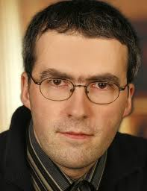

The AES Cipher - Rijndael
Rijndael was selected as the AES in Oct-2000
  Designed by Vincent Rijmen and Joan Daemen in Belgium
  Issued as FIPS PUB 197 standard in Nov-2001
An iterative rather than Feistel cipher
  processes data as block of 4 columns of 4 bytes (128 bits)
  operates on entire data block in every round
Rijndael design:
  simplicity
  has 128/192/256 bit keys, 128 bits data
  resistant against known attacks
  speed and code compactness on many CPUs
V. Rijmen
J. Daemen
Notes:
The Rijndael proposal for AES defined a cipher in which the block length and the key length can be independently specified to be 128,192,or 256 bits. The AES specification uses the same three key size alternatives but limits the block length to 128 bits. Rijndael is an academic submission, based on the earlier Square cipher, from Belgium academics Dr Joan Daemen and Dr Vincent Rijmen. It is an iterative cipher (operates on entire data block in every round) rather than feistel (operate on halves at a time), and was designed to have characteristics of: Resistance against all known attacks, Speed and code compactness on a wide range of platforms, & Design simplicity.

Slide 7



AES Conceptual Scheme
Plaintext (128 bits)
AES
Key (128-256 bits)
Ciphertext (128 bits)

Slide 8
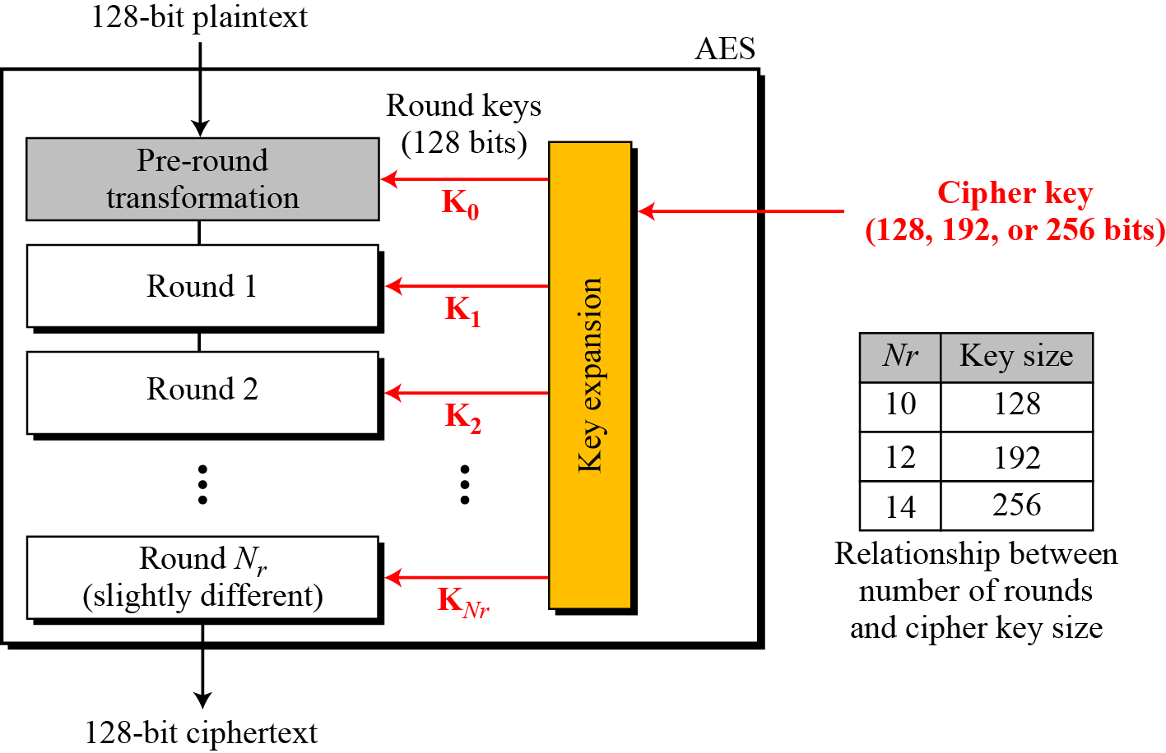
Multiple rounds
Rounds are (almost) identical
  First and last round are a little different
Notes:
The input to the AES encryption and decryption algorithms is a single 128-bit block, depicted in FIPS PUB 197, as a square matrix of bytes .This block is copied into the State array, which is modified at each stage of encryption or decryption. After the final stage, State is copied to an output.
The key is expanded into 44/52/60 lots of 32-bit words (see later), with 4 used in each round.
The data computation then consists of an “add round key” step, then 9/11/13 rounds with all 4 steps, and a final 10th/12th/14th step of byte subs + mix cols + add round key. This can be viewed as alternating XOR key & scramble data bytes operations. All of the steps are easily reversed, and can be efficiently implemented using XOR’s & table lookups.

Slide 9
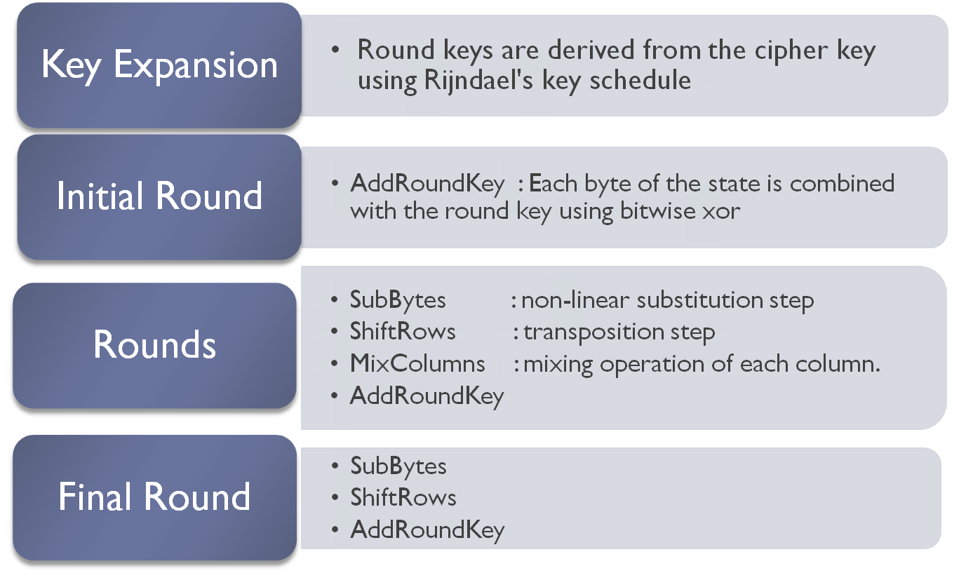
High Level Description
No MixColumns
Notes:
The input to the AES encryption and decryption algorithms is a single 128-bit block, depicted in FIPS PUB 197, as a square matrix of bytes .This block is copied into the State array, which is modified at each stage of encryption or decryption. After the final stage, State is copied to an output.
The key is expanded into 44/52/60 lots of 32-bit words (see later), with 4 used in each round.
The data computation then consists of an “add round key” step, then 9/11/13 rounds with all 4 steps, and a final 10th/12th/14th step of byte subs + mix cols + add round key. This can be viewed as alternating XOR key & scramble data bytes operations. All of the steps are easily reversed, and can be efficiently implemented using XOR’s & table lookups.

Slide 10
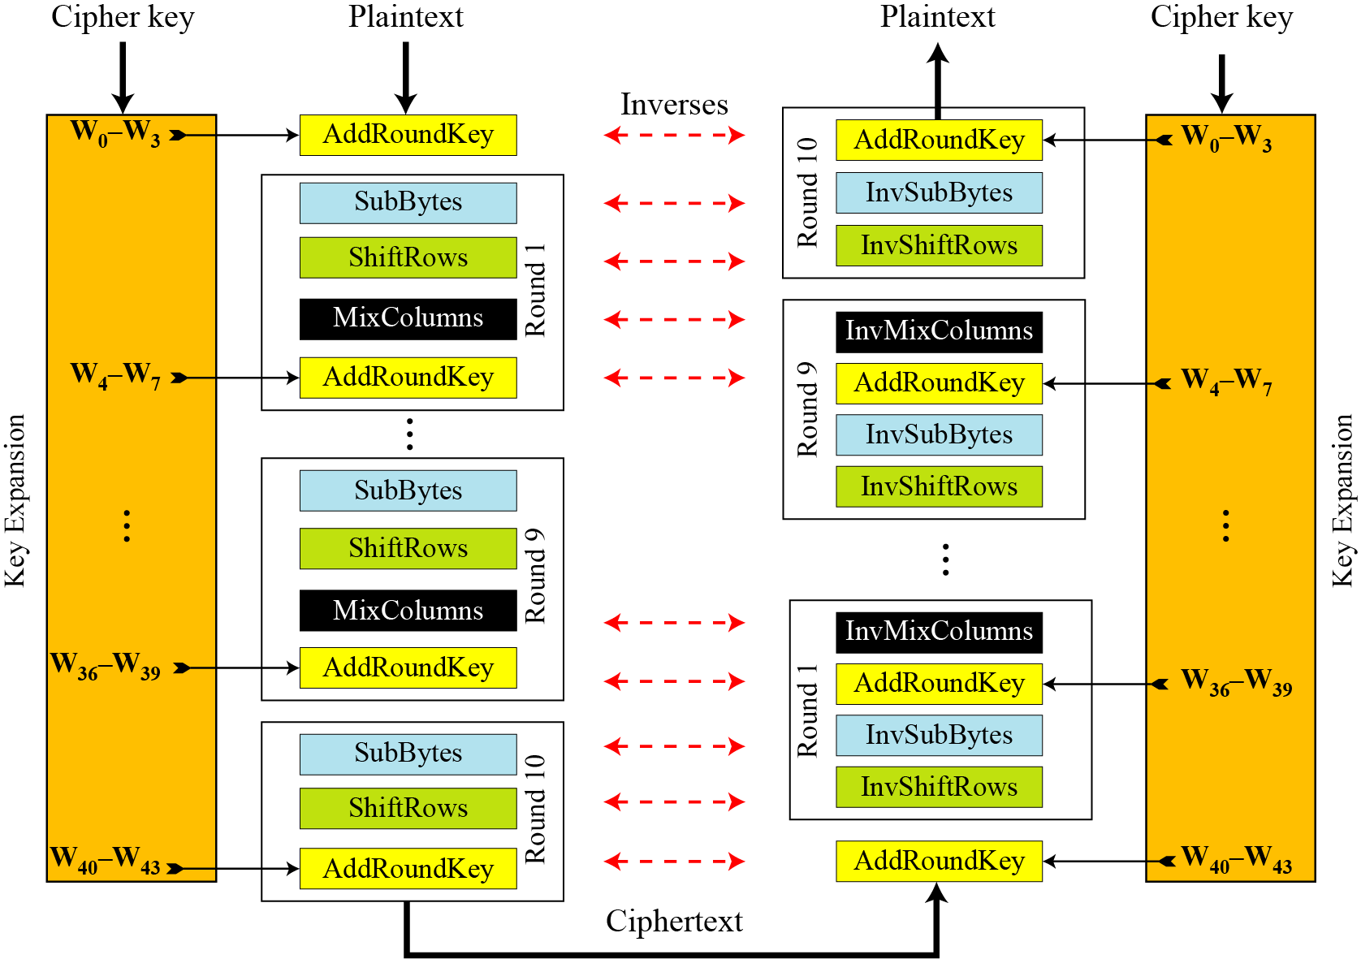
Overall Structure
Notes:
Stallings Figure 5.1 shows the overall structure of AES, as detailed on the previous slide.

Slide 11
128-bit values
Data block viewed as 4-by-4 table of bytes
Represented as 4 by 4 matrix of 8-bit bytes.
Key is expanded to array of 32 bits words
1 byte

Slide 12
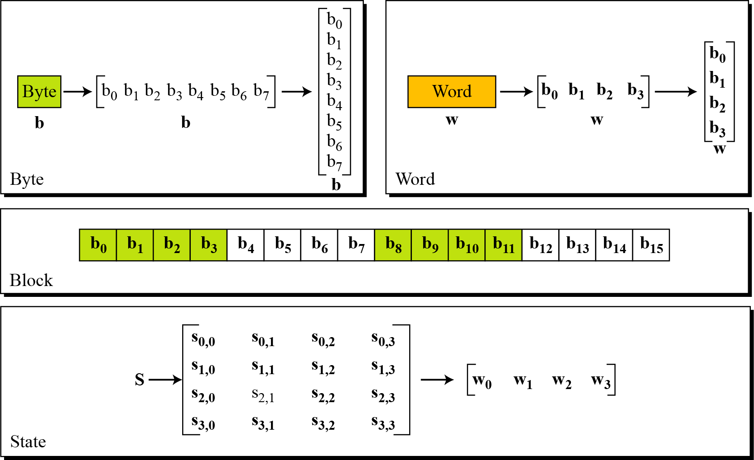
Data Unit

Slide 13
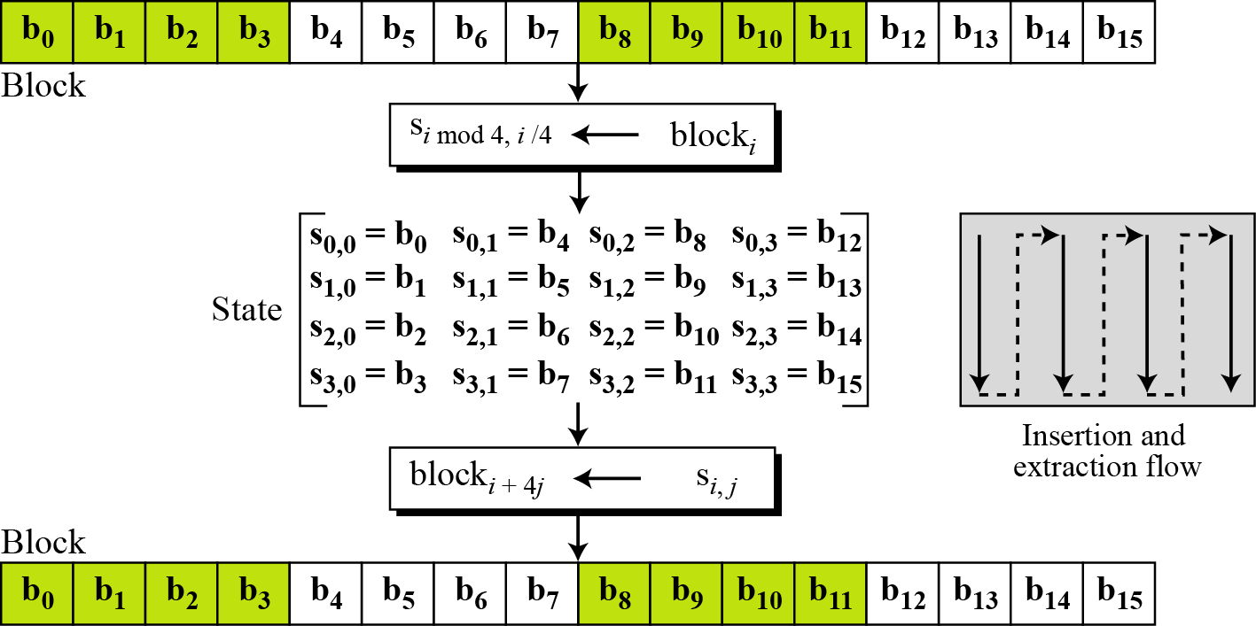
Unit Transformation

Slide 14
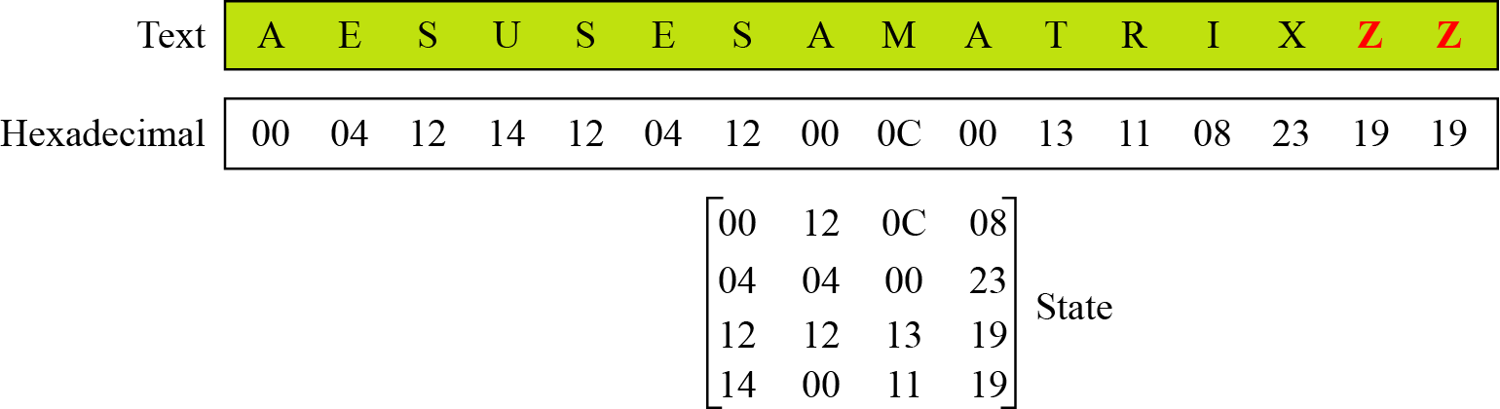
Changing Plaintext to State

Slide 15
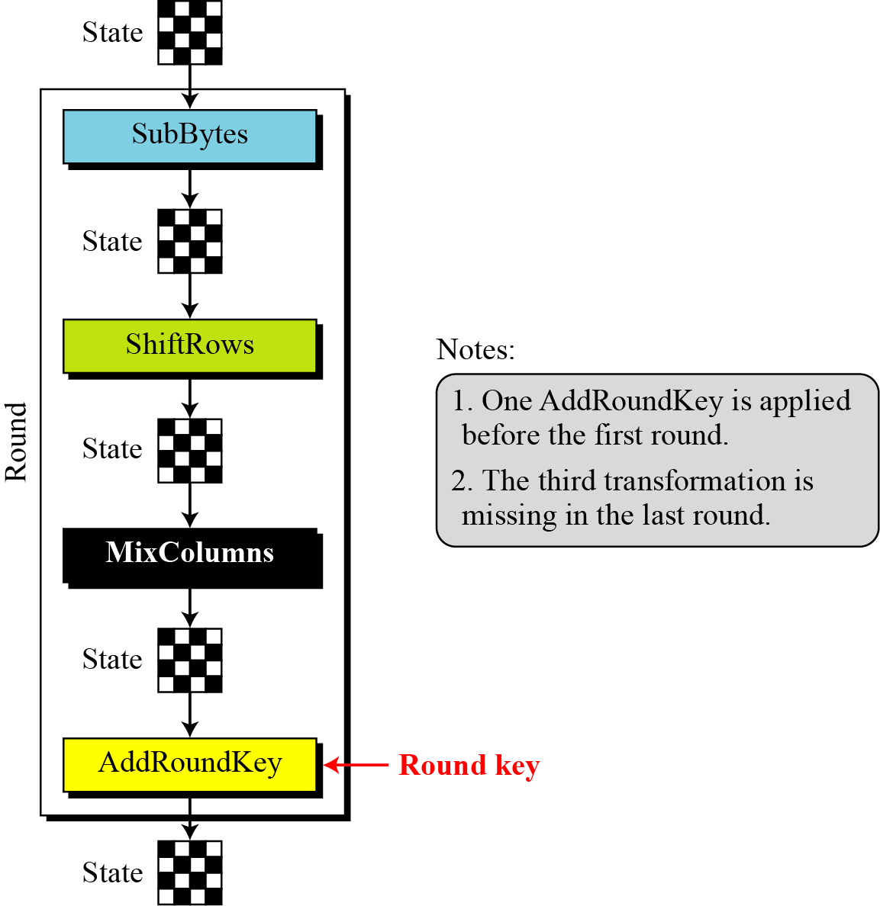
Details of Each Round

Slide 16
SubBytes: Byte Substitution
A simple substitution of each byte
  provide a confusion
Uses one S-box of 16x16 bytes containing a permutation of all 256 8-bit values
Each byte of state is replaced by byte indexed by row (left 4-bits) & column (right 4-bits)
  eg. byte {95} is replaced by byte in row 9 column 5
  which has value {2A}
S-box constructed using defined transformation of values in Galois Field- GF(2⁸)
Galois : pronounce “Gal-Wa”
Notes:
Now discuss each of the four stages used in AES. The Substitute bytes stage uses an S-box to perform a byte-by-byte substitution of the block. There is a single 8-bit wide S-box used on every byte. This S-box is a permutation of all 256 8-bit values, constructed using a transformation which treats the values as polynomials in GF(2⁸) – however it is fixed, so really only need to know the table when implementing. Decryption requires the inverse of the table. These tables are given in Stallings Table 4.5.
The table was designed to be resistant to known cryptanalytic attacks. Specifically, the Rijndael developers sought a design that has a low correlation between input bits and output bits, with the property that the output cannot be described as a simple mathematical function of the input, with no fixed points and no “opposite fixed points”.

Slide 17
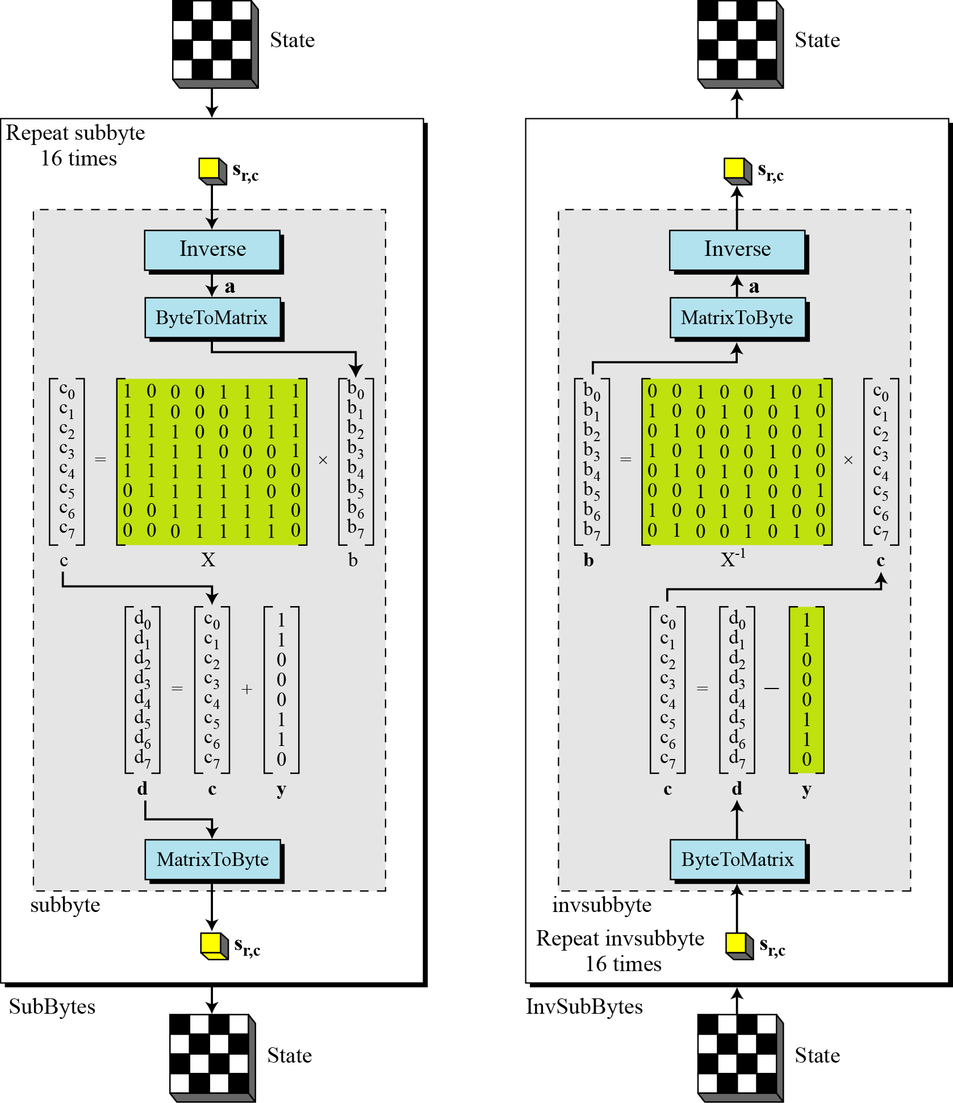
SubBytes and InvSubBytes

Slide 18

SubBytes Operation
The SubBytes operation involves 16 independent byte-to-byte transformations.
Interpret the byte as two hexadecimal digits xy
SW implementation, use row (x) and column (y) as lookup pointer
S_{1,1} = xy₁₆
x’y’₁₆

Slide 19
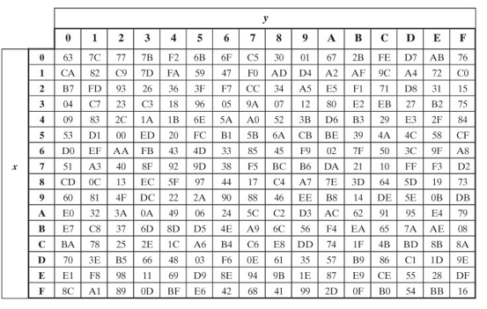
SubBytes Table
Implement by Table Lookup

Slide 20
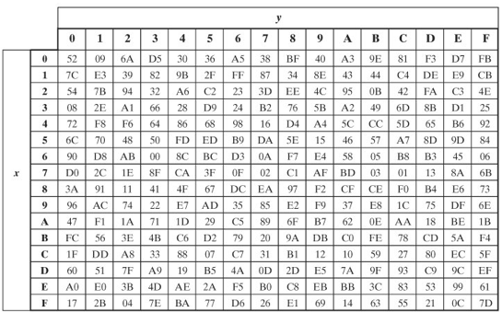
InvSubBytes Table

Slide 21
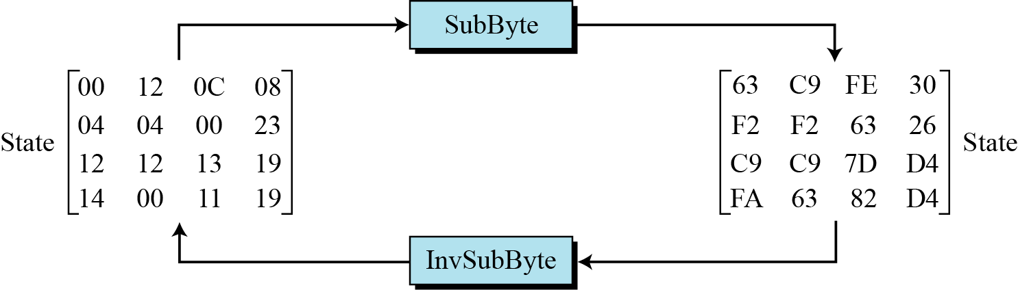
Sample SubByte Transformation
The SubBytes and InvSubBytes transformations are inverses of each other.

Slide 22
ShiftRows
Shifting, which permutes the bytes.
A circular byte shift in each each
  1st row is unchanged
  2nd row does 1 byte circular shift to left
  3rd row does 2 byte circular shift to left
  4th row does 3 byte circular shift to left
In the encryption, the transformation is called ShiftRows
In the decryption, the transformation is called InvShiftRows and the shifting is to the right
Notes:
The ShiftRows stage provides a simple “permutation” of the data, whereas the other steps involve substitutions. Further, since the state is treated as a block of columns, it is this step which provides for diffusion of values between columns. It performs a circular rotate on each row of 0, 1, 2 & 3 places for respective rows. When decrypting it performs the circular shifts in the opposite direction for each row. This row shift moves an individual byte from one column to another, which is a linear distance of a multiple of 4 bytes, and ensures that the 4 bytes of one column are spread out to four different columns.

Slide 23

ShiftRows Scheme
Notes:
Stalling Figure 5.5a illustrates the Shift Rows permutation.

Slide 24
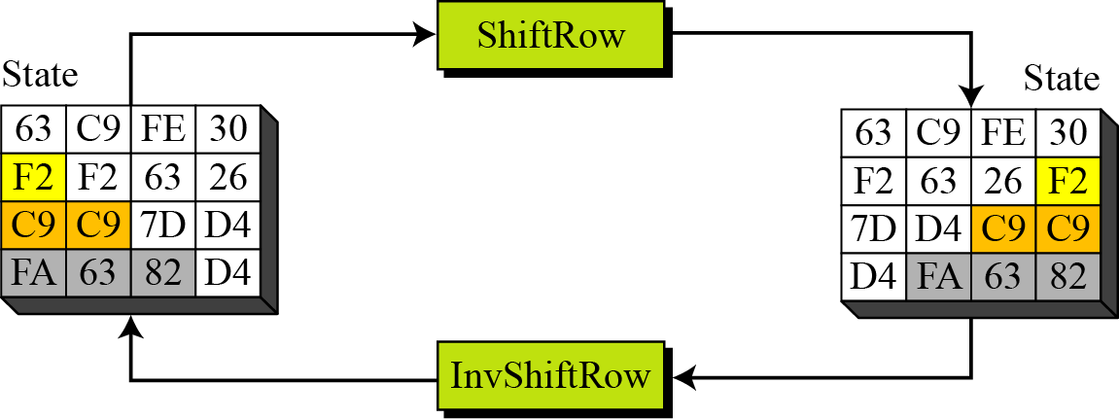
ShiftRows and InvShiftRows

Slide 25
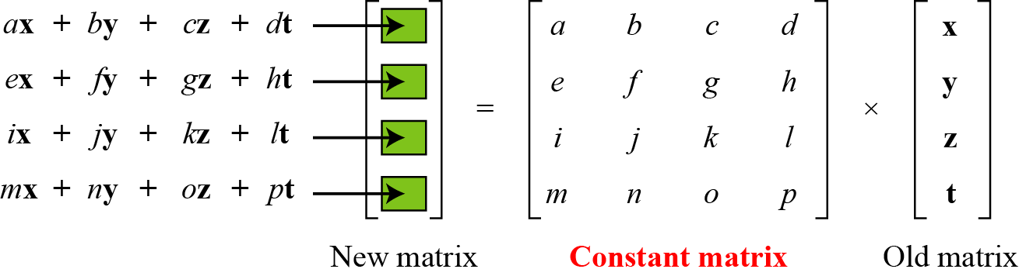
MixColumns
ShiftRows and MixColumns provide diffusion to the cipher
Each column is processed separately
Each byte is replaced by a value dependent on all 4 bytes in the column
Effectively a matrix multiplication in GF(2⁸) using prime poly m(x) =x⁸+x⁴+x³+x+1
Notes:
The MixColumns stage is a substitution that makes use of arithmetic over GF(2^8). Each byte of a column is mapped into a new value that is a function of all four bytes in that column. It is designed as a matrix multiplication where each byte is treated as a polynomial in GF(2⁸). The inverse used for decryption involves a different set of constants.
The constants used are based on a linear code with maximal distance between code words – this gives good mixing of the bytes within each column. Combined with the “shift rows” step provides good avalanche, so that within a few rounds, all output bits depend on all input bits.

Slide 26

MixClumns Scheme
The MixColumns transformation operates at the column level; it transforms each column of the state to a new column.
Notes:
Stalling Figure 5.5b illustrates the Mix Columns transformation.
In practise, you implement Mix Columns by expressing the transformation on each column as 4 equations (Stallings equation 5.4) to compute the new bytes for that column. This computation only involves shifts, XORs & conditional XORs (for the modulo reduction).
The decryption computation requires the use of the inverse of the matrix, which has larger coefficients, and is thus potentially a little harder & slower to implement.
The designers & the AES standard provide an alternate characterisation of Mix Columns, which treats each column of State to be a four-term polynomial with coefficients in GF(2⁸). Each column is multiplied by a fixed polynomial a(x) given in Stallings eqn 5.7. Whilst this is useful for analysis of the stage, the matrix description is all that’s required for implementation.

Slide 27

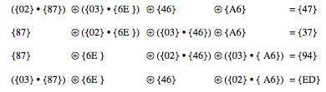
Mix Columns Example

Slide 28
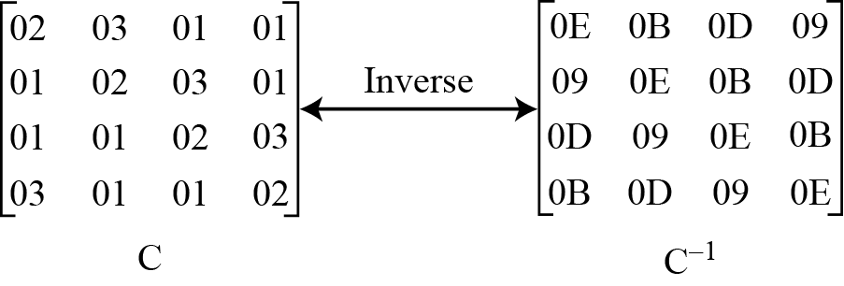
MixColumn and InvMixColumn

Slide 29
AddRoundKey
XOR state with 128-bits of the round key
AddRoundKey proceeds one column at a time.
  adds a round key word with each state column matrix
  the operation is matrix addition
Inverse for decryption identical
  since XOR own inverse, with reversed keys
Designed to be as simple as possible
Notes:
Lastly is the Add Round Key stage which is a simple bitwise XOR of the current block with a portion of the expanded key. Note this is the only step which makes use of the key and obscures the result, hence MUST be used at start and end of each round, since otherwise could undo effect of other steps. But the other steps provide confusion/diffusion/non-linearity. That us you can look at the cipher as a series of XOR with key then scramble/permute block repeated. This is efficient and highly secure it is believed.

Slide 30

AddRoundKey Scheme
Notes:
Stallings Figure 5.4b illustrates the Add Round Key stage, which like Byte Substitution, operates on each byte of state independently.

Slide 31

AES Round
Notes:
Can thus now view all the internal details of the AES round, showing how each byte of the state is manipulated, as shown in Stallings Figure 5.3.

Slide 32
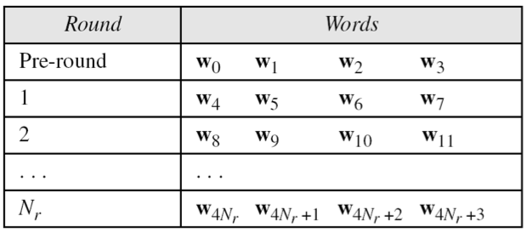
AES Key Scheduling
takes 128-bits (16-bytes) key and expands into array of 44 32-bit words
Notes:
The AES key expansion algorithm takes as input a 4-word (16-byte) key and produces a linear array of words, providing a 4-word round key for the initial AddRoundKey stage and each of the 10/12/14 rounds of the cipher. It involves copying the key into the first group of 4 words, and then constructing subsequent groups of 4 based on the values of the previous & 4th back words. The first word in each group of 4 gets “special treatment” with rotate + S-box + XOR constant on the previous word before XOR’ing the one from 4 back. In the 256-bit key/14 round version, there’s also an extra step on the middle word.

Slide 33
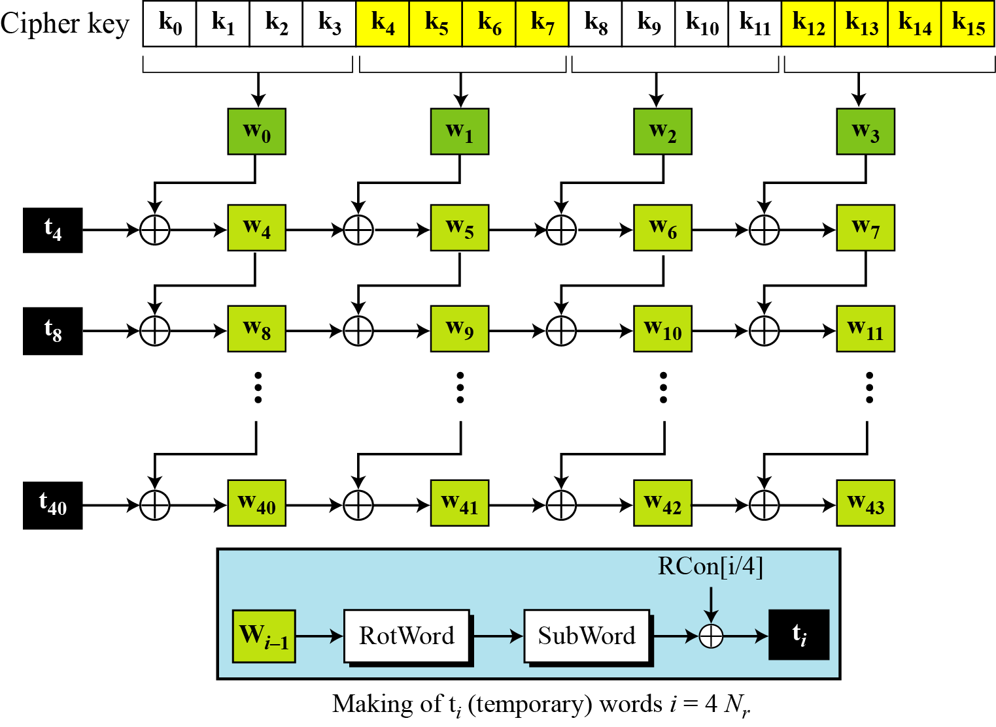
Key Expansion Scheme

Slide 34
Key Expansion submodule
RotWord performs a one byte circular left shift on a word For example:
RotWord[b0,b1,b2,b3] = [b1,b2,b3,b0]
SubWord performs a byte substitution on each byte of input word using the S-box
SubWord(RotWord(temp)) is XORed with RCon[j] – the round constant

Slide 35
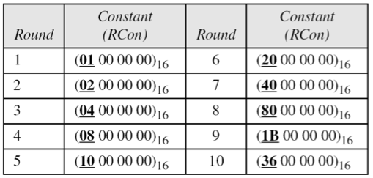
Round Constant (RCon)
RCON is a word in which the three rightmost bytes are zero
It is different for each round and defined as:
RCon[j] = (RCon[j],0,0,0)
where RCon[1] =1 , RCon[j] = 2 * RCon[j-1]
Multiplication is defined over GF(2^8) but can be implement in Table Lookup

Slide 36
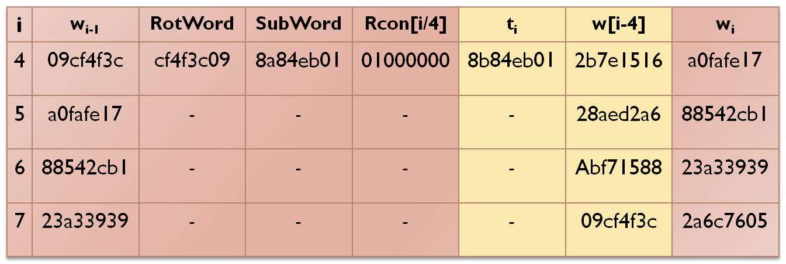
Key Expansion Example (1st Round)
Example of expansion of a 128-bit cipher key
Cipher key = 2b7e151628aed2a6abf7158809cf4f3c
w0=2b7e1516 w1=28aed2a6 w2=abf71588 w3=09cf4f3c

Slide 37
AES Security
AES was designed after DES.
Most of the known attacks on DES were already tested on AES.
Brute-Force Attack
  AES is definitely more secure than DES due to the larger-size key.
Statistical Attacks
  Numerous tests have failed to do statistical analysis of the ciphertext
Differential and Linear Attacks
  There are no differential and linear attacks on AES as yet.

Slide 38
Implementation Aspects
The algorithms used in AES are so simple that they can be easily implemented using cheap processors and a minimum amount of memory.
Very efficient
Implementation was a key factor in its selection as the AES cipher
AES animation:
  http://www.cs.bc.edu/~straubin/cs381-05/blockciphers/rijndael_ingles2004.swf
Notes:
AES can also be very efficiently implemented on an 32-bit processor, by rewriting the stage transformation to use 4 table lookups & 4 XOR’s per column of state. These tables can be computed in advance using the formulae shown in the text, and need 4Kb to store.
The developers of Rijndael believe that this compact, efficient implementation was probably one of the most important factors in the selection of Rijndael for AES.

Slide 39
Block Cipher Modes

Slide 40
Multiple Blocks
How to encrypt multiple blocks?
Do we need a new key for each block?
  As bad as (or worse than) a one-time pad!
Encrypt each block independently?
Make encryption depend on previous block, i.e., “chain” the blocks together?
How to handle partial blocks?

Slide 41
Modes of Operation
Three most popular modes:
  Electronic Codebook (ECB) mode
    Encrypt each block independently
    Most obvious, but has a serious weakness
  Cipher Block Chaining (CBC) mode
    Chain the blocks together
    More secure than ECB, virtually no extra work
  Counter Mode (CTR) mode
    Acts like a stream cipher
    Popular for random access

Slide 42
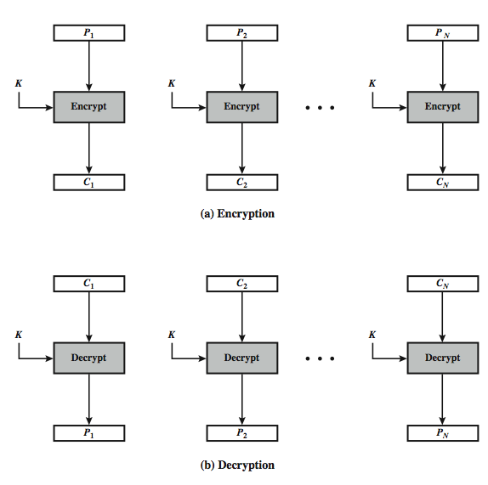
Electronic Codebook Book (ECB)

Slide 43
ECB Mode
Notation: C=E(P,K)
Given plaintext P₀,P₁,…,P_{m},…
Most obvious way to use a block cipher:
EncryptDecrypt
C₀ = E(P₀, K) P₀ = D(C₀, K)
C₁ = E(P₁, K) P₁ = D(C₁, K)
C₂ = E(P₂, K) … P₂ = D(C₂, K) …

Slide 44
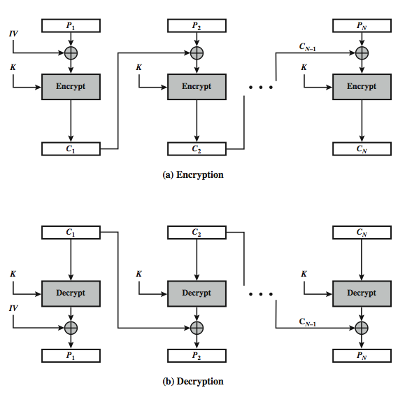
Cipher Block Chaining (CBC)

Slide 45
CBC Mode
Blocks are “chained” together
A random initialization vector, or IV, is required to initialize CBC mode
IV is random, but not secret
EncryptionDecryption
C₀ = E(IV ⊕P₀, K), P₀ = IV ⊕D(C₀, K),
C₁ = E(C₀ ⊕P₁, K), P₁ = C₀ ⊕D(C₁, K),
C₂ = E(C₁ ⊕P₂, K),… P₂ = C₁ ⊕D(C₂, K),…

Slide 46
Advantages and Limitations of CBC
A ciphertext block depends on all blocks before it.
Sequential access of ciphertext
need Initialization Vector (IV)
  which must be known to sender & receiver
  hence IV must either be a fixed value
  or must be sent encrypted in ECB mode before rest of message

Slide 47
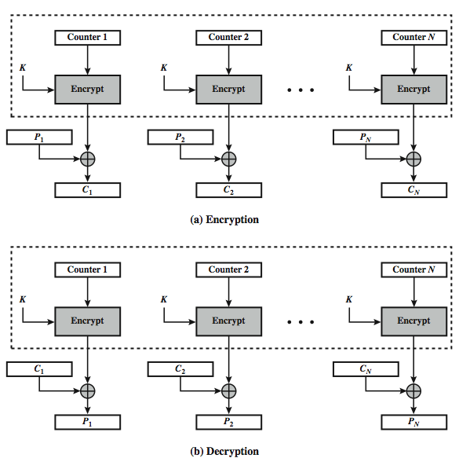
Counter (CTR)

Slide 48
Counter Mode (CTR)
CTR is popular for random access
Use block cipher like stream cipher
EncryptionDecryption
C₀ = P₀ ⊕E(IV, K), P₀ = C₀ ⊕E(IV, K),
C₁ = P₁ ⊕E(IV+1, K), P₁ = C₁ ⊕E(IV+1, K),
C₂ = P₂ ⊕E(IV+2, K),… P₂ = C₂ ⊕E(IV+2, K),…

Slide 49
Advantages and Limitations of CTR
efficiency
  can do parallel encryptions in h/w or s/w
  good for bursty high speed links
random access to encrypted data blocks
provable security (good as other modes)

Slide 50
ECB Cut and Paste
Suppose plaintext is
Alice digs Bob. Trudy digs Tom.
Assuming 64-bit blocks and 8-bit ASCII:
P₀ = “Alice di”, P₁ = “gs Bob. ”,
P₂ = “Trudy di”, P₃ = “gs Tom. ”
Ciphertext: C₀,C₁,C₂,C₃
Trudy cuts and pastes: C₀,C₃,C₂,C₁
Decrypts as
Alice digs Tom. Trudy digs Bob.
Identical plaintext blocks yield same ciphertext blocks.

Slide 51
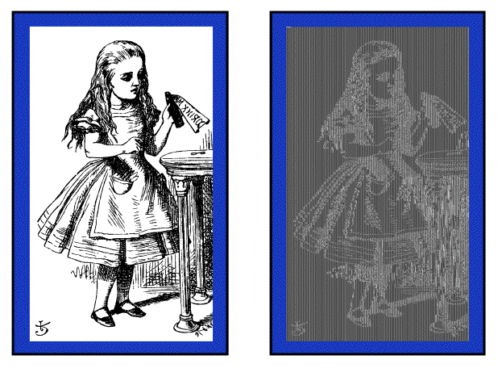
Alice Hates ECB Mode
Alice’s uncompressed image, and ECB encrypted (TEA)
Why does this happen?
Same plaintext block ⇒ same ciphertext!

Slide 52
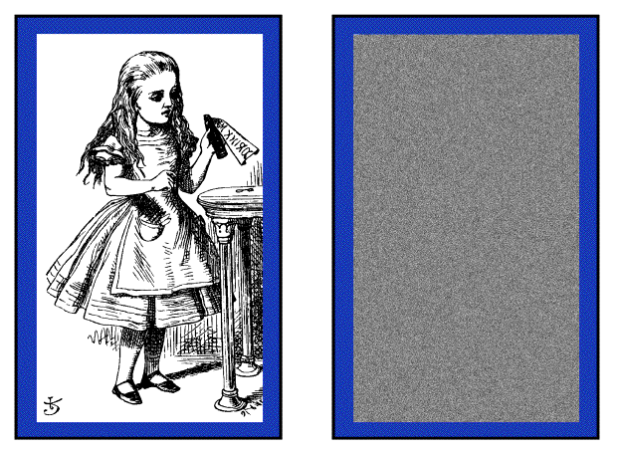
Alice Likes CBC Mode
Alice’s uncompressed image, Alice CBC encrypted (TEA)
Why does this happen?
Same plaintext yields different ciphertext!

Slide 53
Data Integrity
Integrity- detect unauthorized writing (i.e., modification of data)
Example: Inter-bank fund transfers
  Confidentiality is nice, but integrity is critical
Encryption provides confidentiality (prevents unauthorized disclosure)
Encryption alone does not provide integrity
  ECB cut-and-paste, etc.

Slide 54
MAC
Message Authentication Code (MAC)
  Used for data integrity
  Integrity not the same as confidentiality
MAC is computed as CBC residue
  That is, compute CBC encryption, but only save the final ciphertext block.

Slide 55
MAC Computation
MAC computation (assuming N blocks)
C₀ = E(IV ⊕P₀, K),
C₁ = E(C₀ ⊕P₁, K),
C₂ = E(C₁ ⊕P₂, K),…
C_{N−1} = E(C_{N−2} ⊕P_{N−1}, K) = MAC
MAC sent with IV and plaintext.
Receiver does same computation and verifies that result agrees with MAC
Receiver must also know the key K

Slide 56
Why does a MAC work?
Suppose Alice has 4 plaintext blocks
Alice computes
C₀= E(IV⊕P₀,K), C₁= E(C₀⊕P₁,K),
C₂= E(C₁⊕P₂,K), C₃= E(C₂⊕P₃,K) = MAC
Alice sends IV,P₀,P₁,P₂,P₃and MAC to Bob
Suppose Trudy changes P₁toX
Bob computes
C₀= E(IV⊕P₀,K), C₁= E(C₀⊕X,K),
C₂= E(C₁⊕P₂,K), C₃= E(C₂⊕P₃,K) = MAC≠MAC
Error propagates into MAC
Trudy can’t change MAC to MAC without K

Slide 57
Confidentiality and Integrity
Encrypt with one key, MAC with another key
Using different keys to encrypt and compute MAC works, even if keys are related
Confidentiality and integrity with one “encryption” is a research topic!

